Slide 1

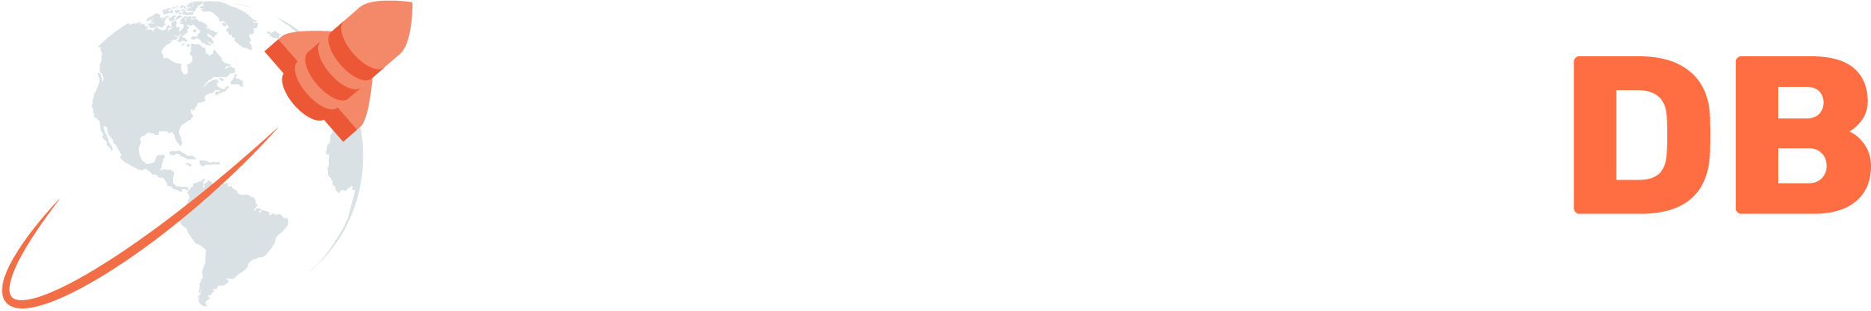
Introducing Yugabyte

Slide 2
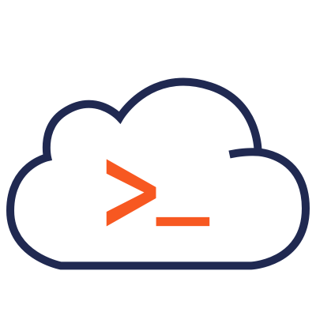
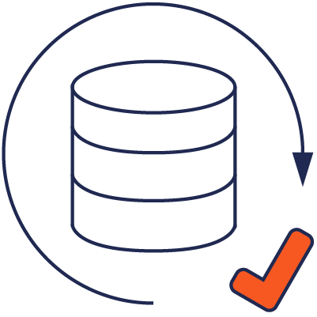
What is YugaByte DB?
NoSQL + SQL
Cloud Native
2￼

Slide 3
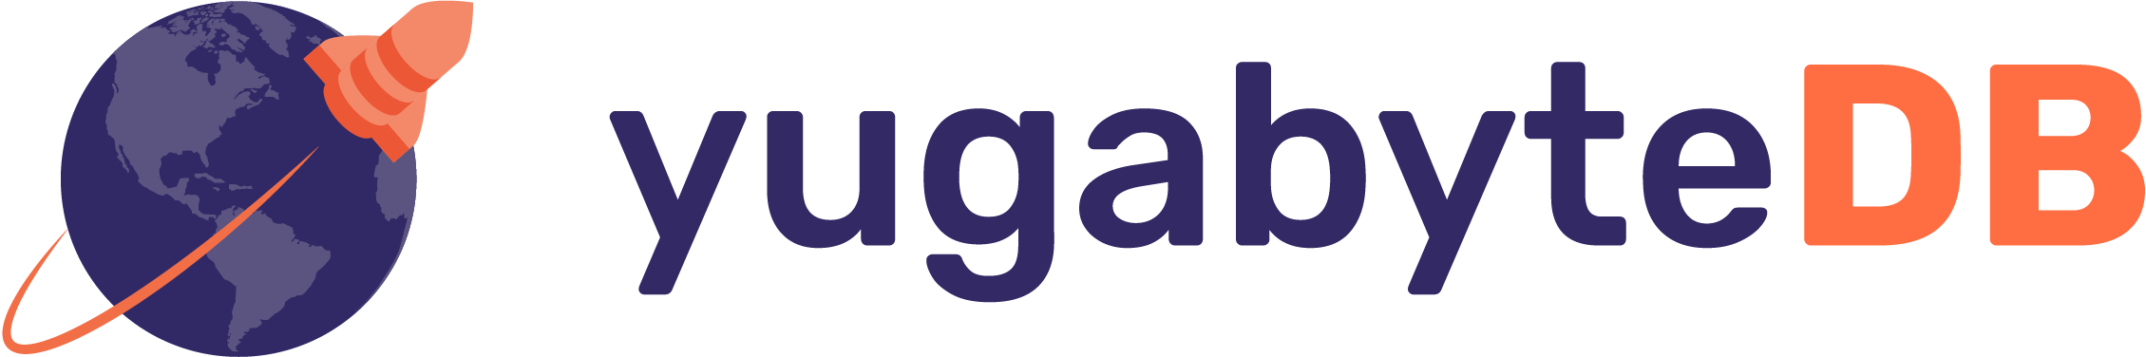

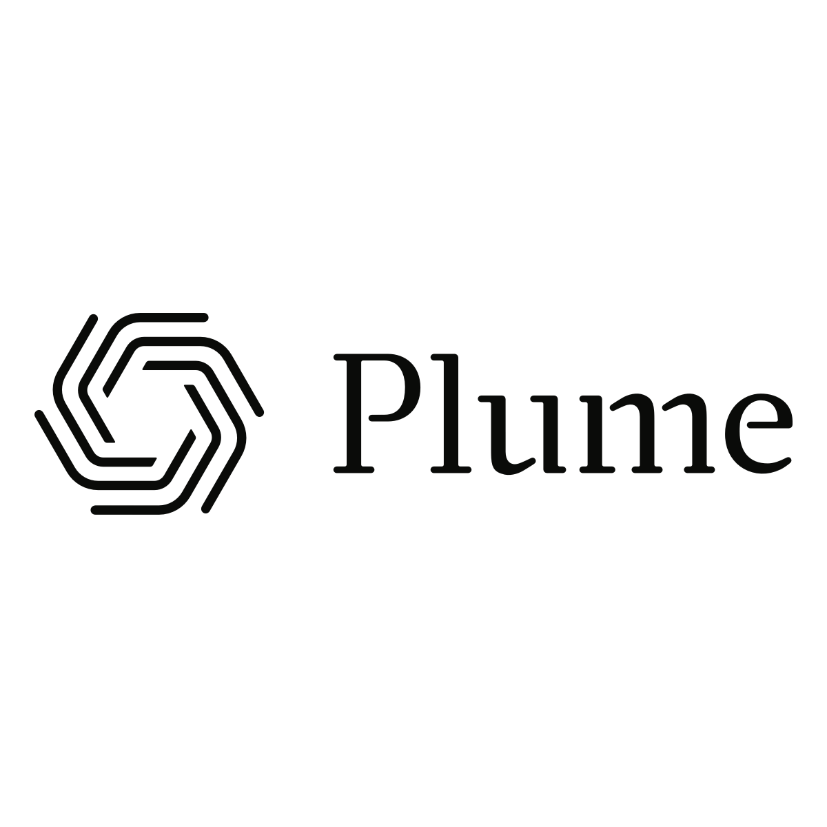




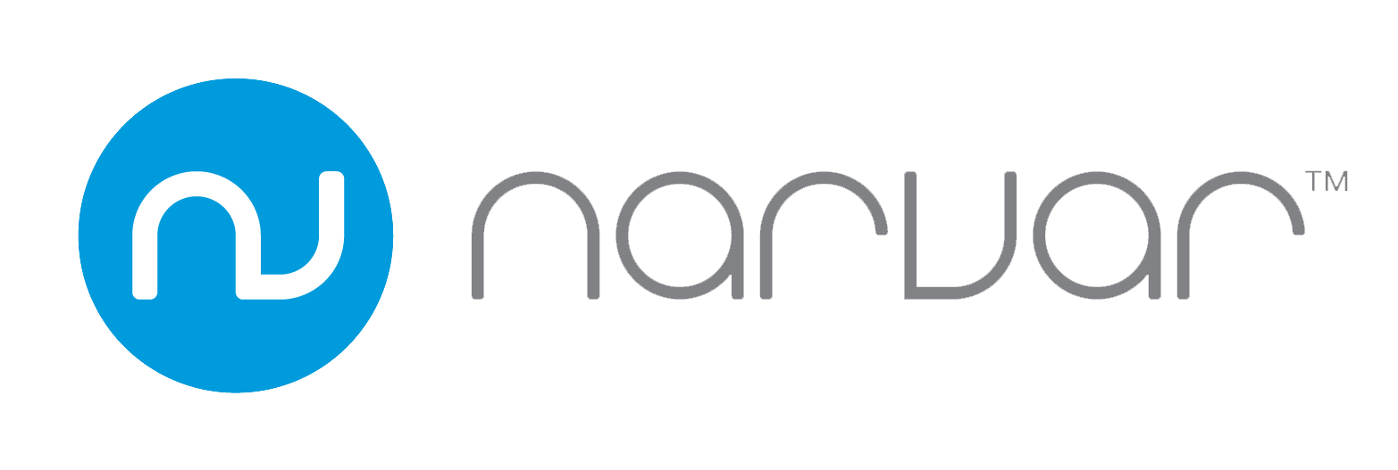
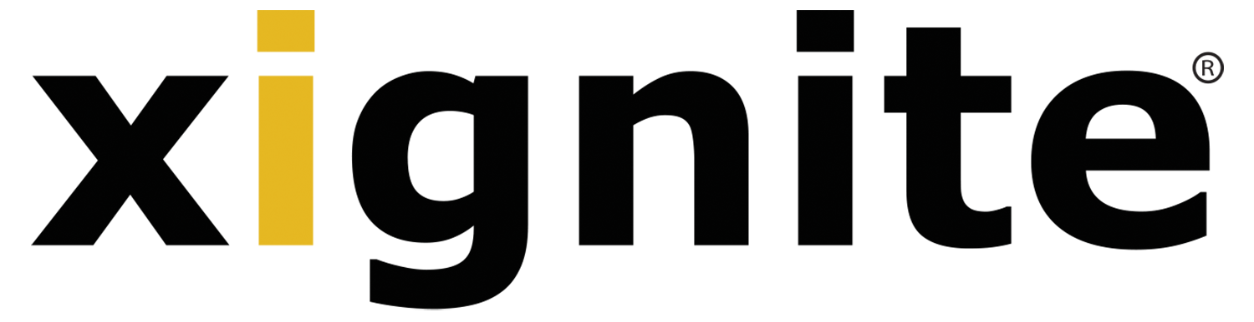
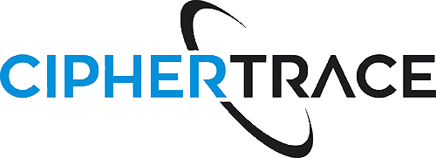
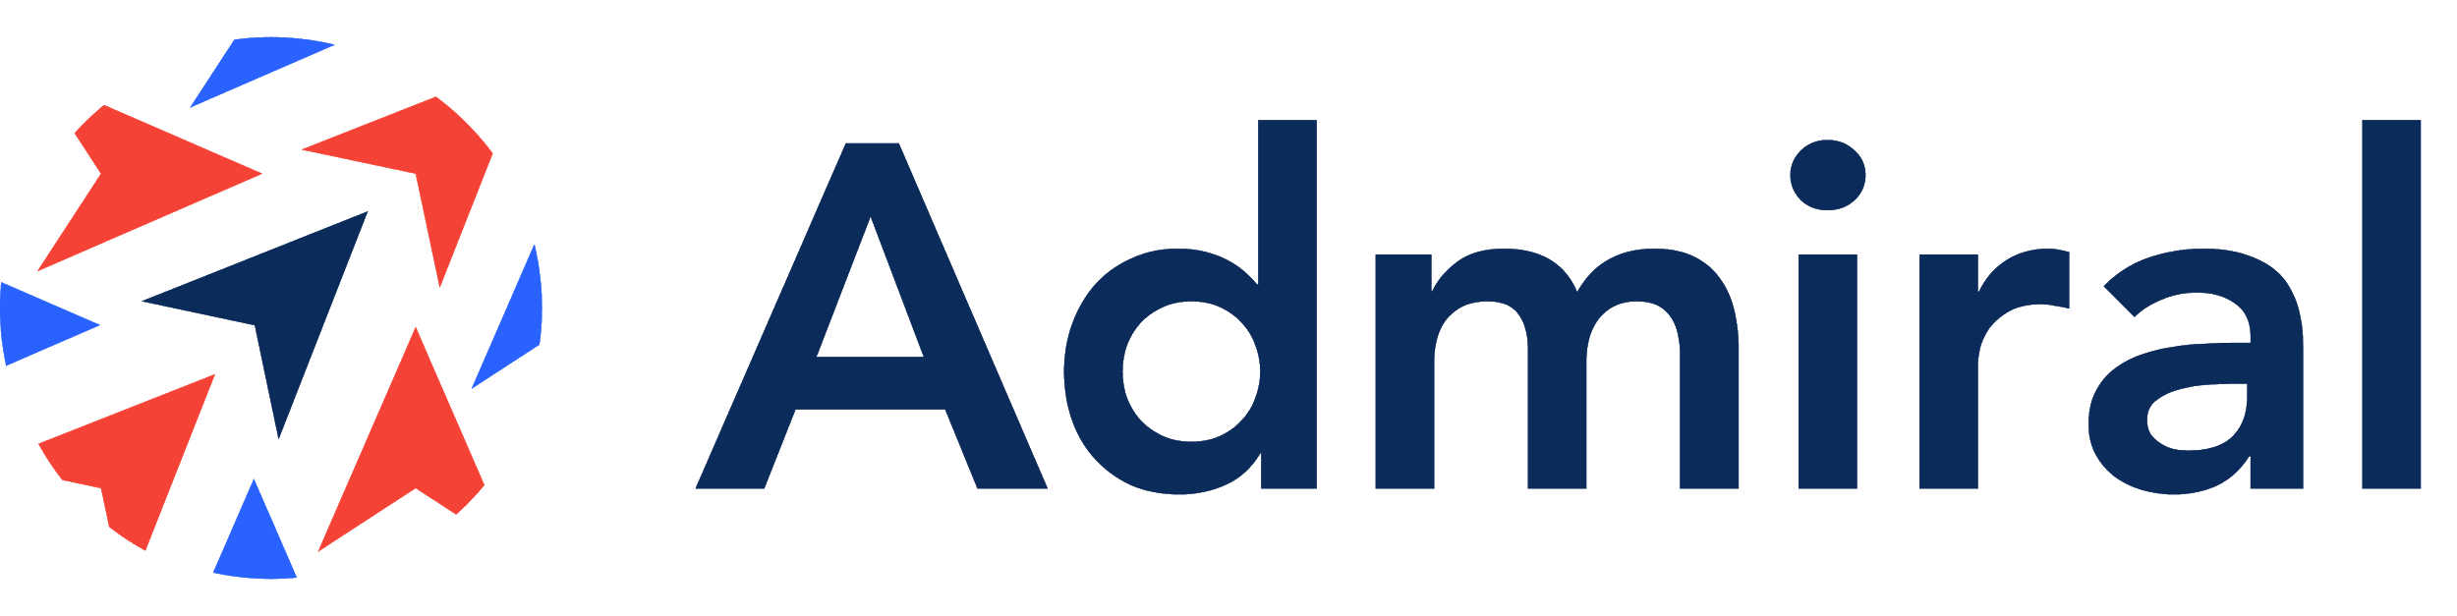
Transactional, distributed SQL database designed for resilience and scale
for building planet-scale cloud services
100% open source, PostgreSQL compatible, enterprise-grade RDBMS
…..built to run across all your cloud environments
Notes:
Key Messages and takeways
Without going too deep, establish we are a open source database, introduce the notion of “distributed SQL”
Most important, establish credibility - we are used by large companies
Talk track
Yugabyte is a company founded on the belief that the next decade will see a major change in the systems of record that enterprises use to run their business and offer digital services
We focus on “Distributed SQL” - which we will describe later in the discussion - but think of it as the next generation of SQL databases designed to support Enterprises as they move into a Cloud Native, Digital-led world
YugabyteDB is used by both smaller companies and by the Fortune 500 alike - by retailers, advertisers, financial services companies, telecom and others.

Slide 4
YugaByte Story started
with...

Slide 5
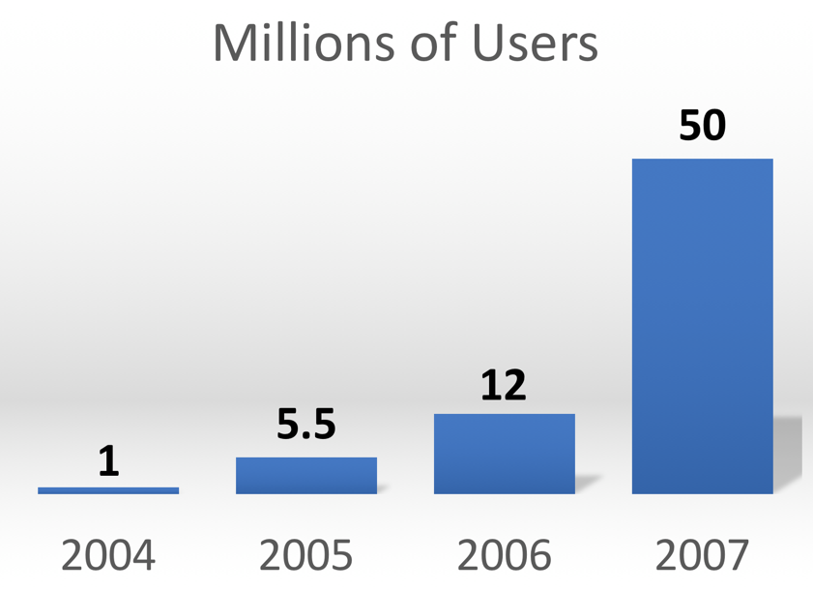

Facebook in 2007
5￼

Slide 6
Facebook in 2008-2009
How to scale to a billion users?
Also: how to survive the week?
6￼

Slide 7
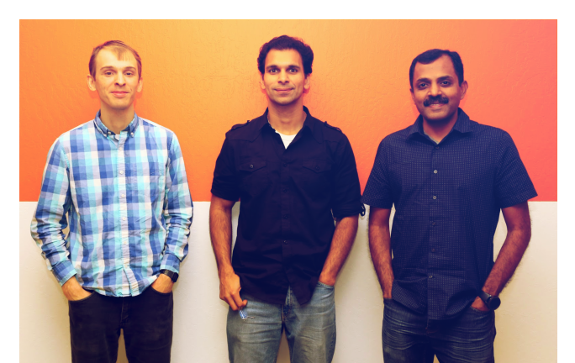
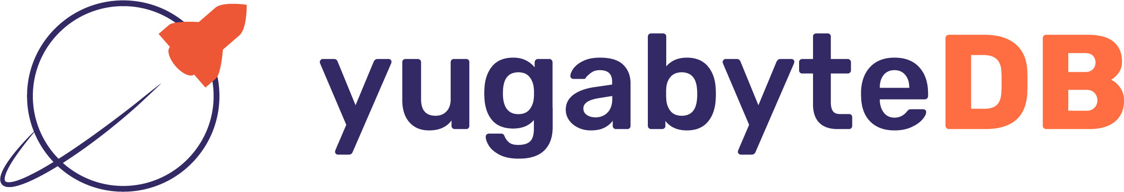
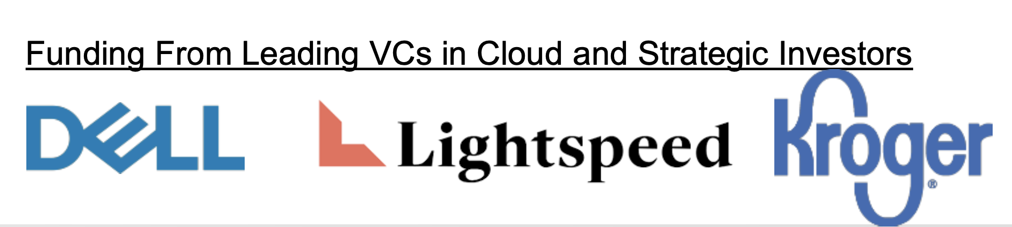
YugabyteDB: Created by practitioners, born in the trenches
Founders
At scale data architecture AND operations
Core DB Team at Facebook 2007 - 2013
Scaled data platforms from 30m to 1.4 Bn users
Ran DBaaS: +1 Trillion ops/day, +100 PB
Addressing enterprise requirements
Built distributed storage layer at Nutanix
Mikhail
Karthik
Kannan
Traditional RDBMS expertise
10 years as Core Oracle DB engineer
Proven database innovation
Co- Creators of Cassandra and Hbase
Transactional, cloud native DB for microservices and containers… with HA and geo- distribution, accessed via familiar APIs... all in Open source
7

Slide 8
Global Retailer
Product Catalog Matching
Azure, 3-region, 24 nodes
Consolidate items under a unique product ID
Alternate Key / Primary (AKPK) Mapping
Azure, 3-region, 18 nodes
Lookup products by identifiers
250K txns/sec reads at very low-latency
Using read-from-followers, plan to add read-replicas
Item Grouping - Next Use Case
Group items to increase discoverability
Maximize retail margin/volume
Incentivize buying group of items
2 microservices live as of Aug 2020
42 total nodes in Azure
250K txns / sec in one use case
Black Friday, Cyber Monday peaks
$10MM lost revenue recovered

Slide 9
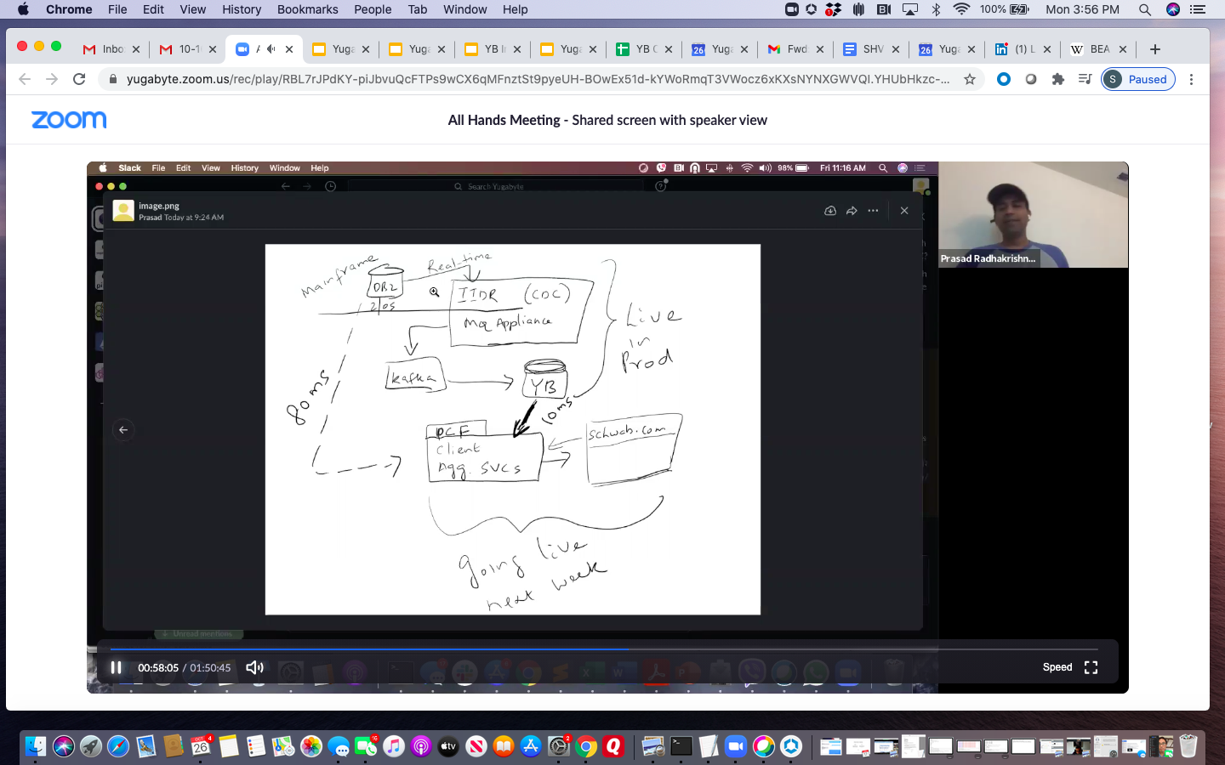
Large Financial Institution
Cloud-native database on hybrid cloud to improve the customer experience.
Supporting mission critical, production workloads that previously could only be handled by the mainframe
Kafka facilitating real-time CDC / events
Microservices implemented in Spring
YugabyteDB database of choice
White-board from Customer Production Team:
Microservices on YugabyteDB yields ~10x better perf
10x <10ms 200K
Performance Latency TPS

Slide 10
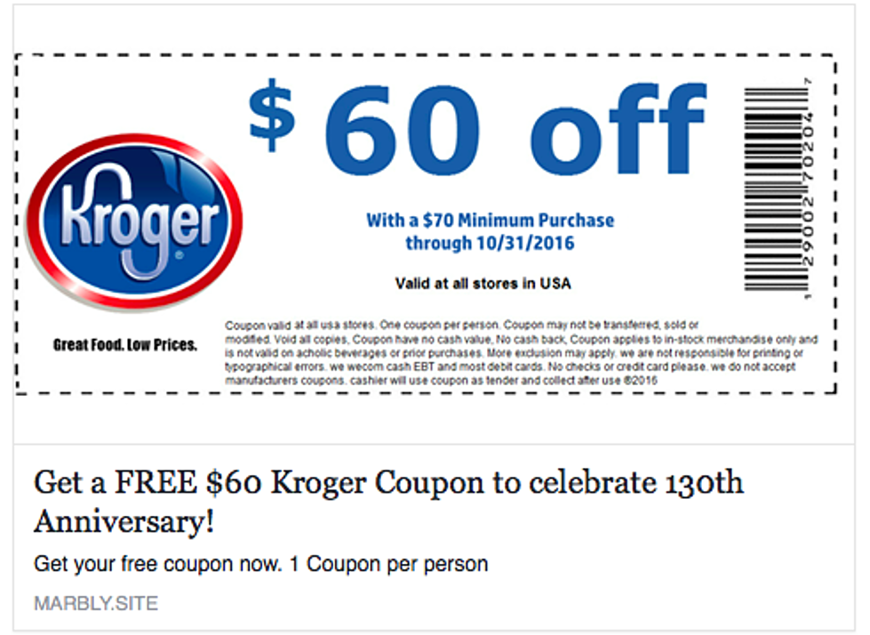
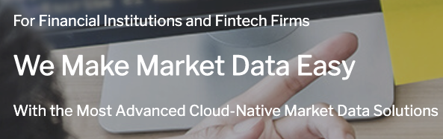
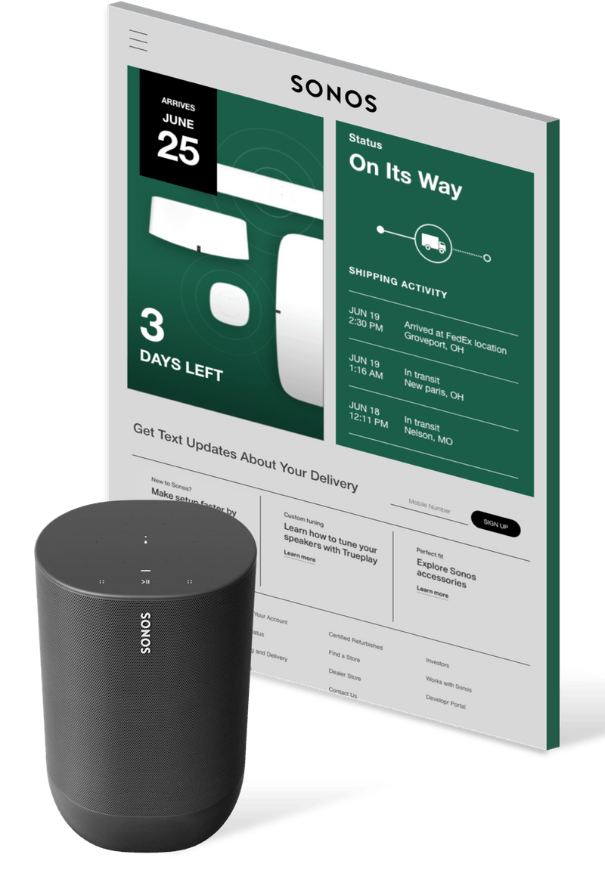
Enabling business outcomes
System of Record driving shopping list service
Designed to be Multi-Cloud on GCP and Azure
Scaling to 42 states, and 9m shoppers
Real-time APIs for financial services data
14 Billion requests per day with data from over 100 world-wide exchanges
Serves major financial tech and services firms from Betterment to Schwab
Retail personalization platform serving 600+ retailers like Walmart and Nike
Designed to be Multi-cloud/Multi-AZ and tuned to handle Black Friday
Notes:
Key Messages and takeways to impart
Real customers are using Yugabyte in Production, for customer-facing, business-critical apps
These are “transformational outcomes” - they enable our customers to effectively compete
Talk track
We partner with enterprises to help achieve transformational business outcomes.
We know we contribute to just one part of their digital modernization journey, but we are trusted in mission-critical, customer-facing and revenue-generating apps and services
Kroger is using Yugabyte for their key shopping list service and is planning to grow their use of YB to the entire shopping experience.
Kroger evaluated spanner and other technologies but wants to maintain their cloud service provider independence. Today they’re on GCP but they have plans for deployments on Azure as well.
They wanted a SQL database (and were one of our first YSQL customers) that is globally consistent, transactional and horizontally scalable.
Xignite is a name that people in the financial services industry know. Their system consumes data from over a 100 financial exchanges around the world. Stock market tick-by-tick data is real-time and they must consume this in very low latency.
All of their data is based on a microservices API architecture allowing finserv and fintech firms to outsource their data processing to Xignite. This isn’t just “tick by tick” but also proprietary data from their customers.
Their daily volume is massive with over 10B operations and at peak 200k transactions per second.
Narvar handles personalization for retailers - retailers like Nike and Walmart. Their workloads are “spikey”with days like Black Friday push there services aggressively. Today with Covid we are hearing things like everyday is Black Friday! For them multiple clouds, multiple availability zones, staying up even when things change aren’t just database features they are key business requirements.

Slide 11
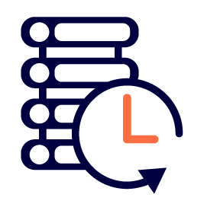

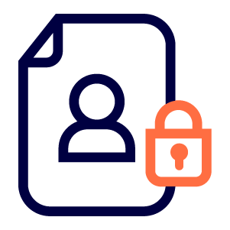
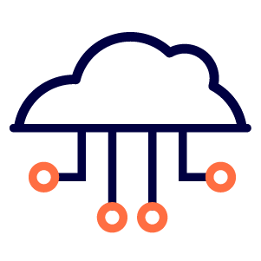
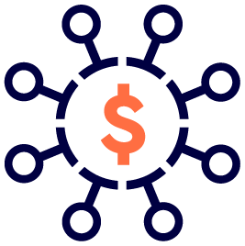
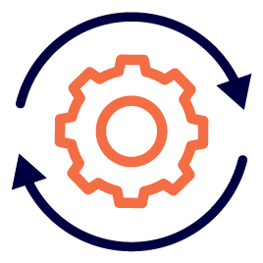
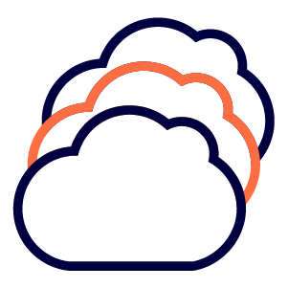
Business innovation is putting pressure on traditional systems of record
Transactional systems now require much greater scale and elasticity
Customers expect real time, always-on interactions whenever and wherever they are
Data sovereignty and new regulations like GDPR geo-distribution
Cloud native architectures demand flexibility and expect resilience
Traditional licensing models are expensive and proprietary
Existing systems of record were not designed for rapid product iteration
Strategic need to maintain cloud vendor independence
Notes:
Key Messages and takeaways to impart
The world is charging ahead with change - and traditional Systems of Record (think traditional Oracle) are struggling to keep up
Talk track
As Business Innovation and customer expectations fuel each other forwards, the traditional SOR are at their limit
Personalized real time interactions demand scale and low latency
Business models based on locality and mobile transactions still require consistency and accuracy
Modern Private and Public compute infrastructure is changing how systems are architected and where they are deployed
Agile development driving rapid changes to applications and this needs to be matched by flexibility in the System of Record
There have been massive disruptions to business and governments this year which is accelerating the move to virtual supply chains …. AND YET there are more rules about where data can live.
IT has been tasked with a lot in the face of a constant talent shortage - which regardless of where you stand on the issues, is only going to get worse with the latest changes to H1B rules, etc. So we must automate and do more with less resources.
Vendor independence is not just a CIO concern, but increasing includes the full c-suite
Finally, no one says they love oracle’s pricing models!

Slide 12
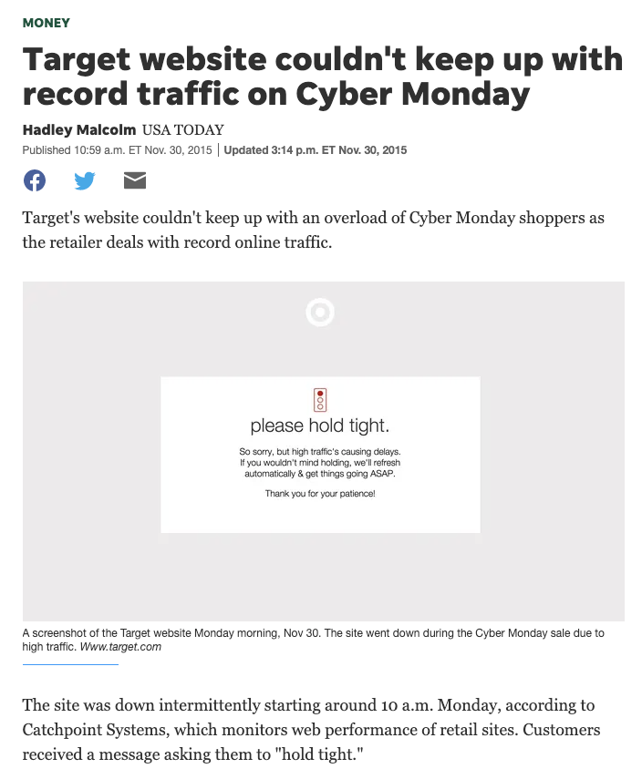
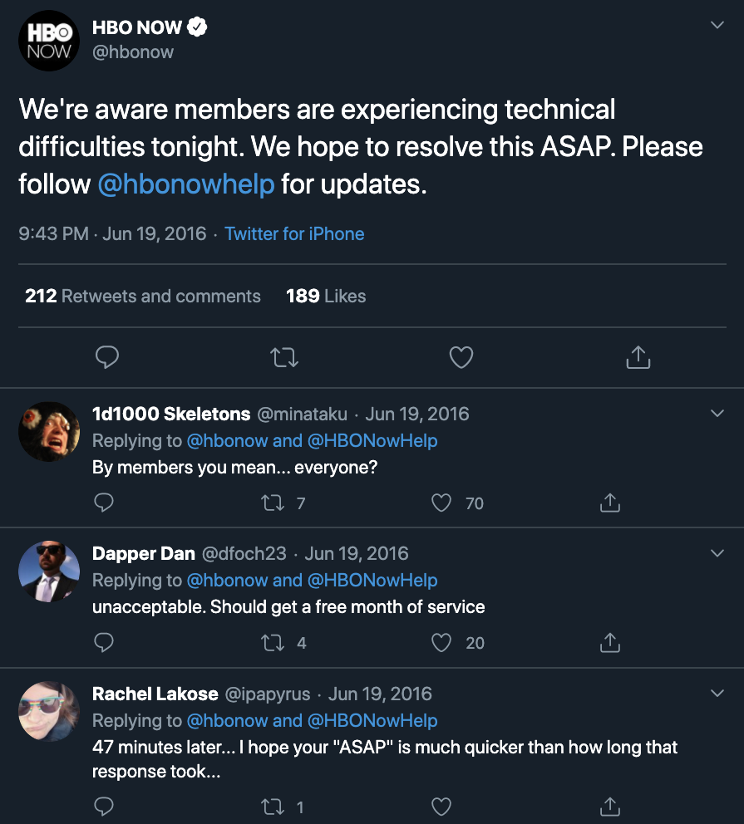
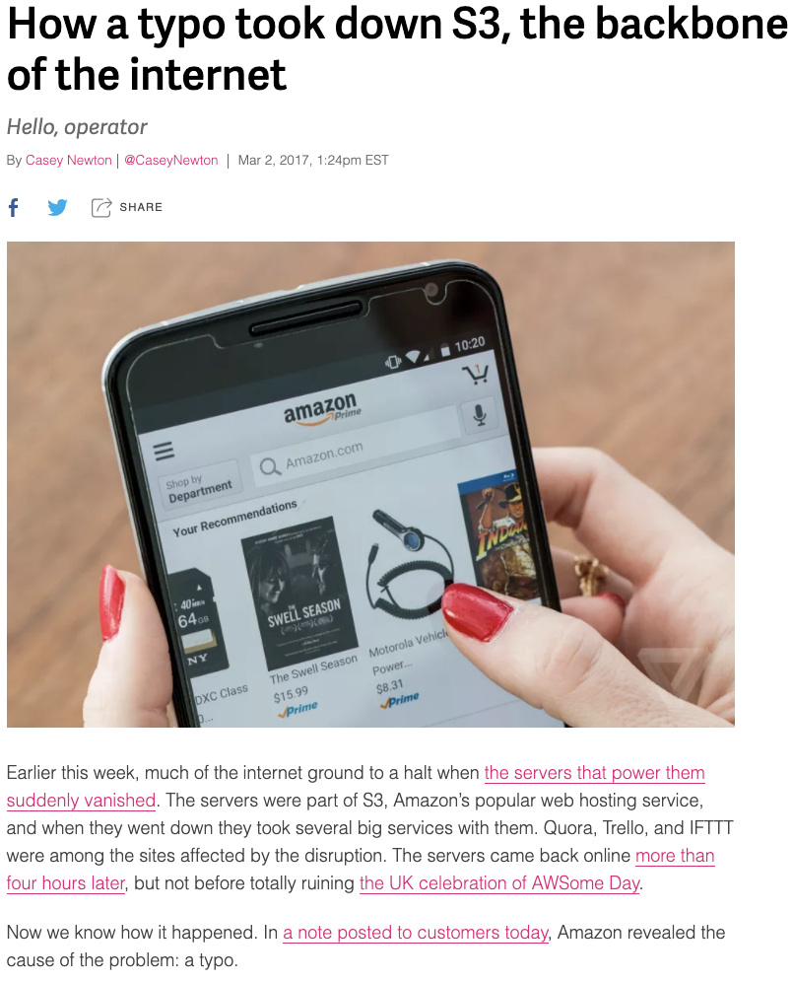

A hard problem catches up with you...
Notes:
Key Messages and takeways to impart
Managing data today is hard -and any errors are flagged publicly and vocally
Talk track
Whether it is unplanned or planned maintenance, a scale fail, quality of service problems or just excessive latency -- any outage of a major service is newsworthy.
Customers expect 24x7 availability, they expect real time interactions and transactions, they expect the same experience wherever and whenever they are… and yet traditional transactional systems are not designed to be scale-out or distributed
(note that tweet is during like the season finale of game of thrones)

Slide 13
Database for my transactional apps, how do I ……..?
…. achieve horizontal scale without compromising uptime or data integrity?
…. ensure high availability and resilience in the face of failures, upgrades and patches ?
…. deploy and manage services on Kubernetes and the Cloud and across Clouds?
…. minimize the disruption of moving off traditional databases?
…. spend less time managing the database by easily offering a “DB as a service” to developers?
…. boost developer productivity by supporting modern tools and frameworks
…. keep data secure without compromising productivity
…. achieve low latency at scale for real time applications
…. adhere to cloud native architectures (more databases) while keeping cost in check?
How do I do all of this and give my developers the rich database feature set they are familiar with ?
Notes:
Key Messages and takeaways to impart
Most enterprises are facing similar challenges
Talk track
Over and over we hear the same set of questions from both users and Enterprises….For my Transactional apps
What is the right data architecture for my microservices based applications, how will they scale effortlessly?, how do I manage many more DBs, how I maintain data integrity?
How do we manage these microservices on Kubernetes and in the Cloud while maintaining security yet following rules like GDPR
Can I delight my developers with a simple experience that integrates with modern developer frameworks like GraphQL.
How can I give the Operators the tools to offer a DbaaS without spending all their time managing the database
I just touched on a few… but ultimately it comes down to ensuring that developers can access the rich database feature set they are familiar with , but having the DB optimized for Cloud native architectures and use cases

Slide 14
Current database options force trade offs …….
Operational Excellence
Developer Productivity
NoSQL
SQL
Cost Effective
Full Featured
OR
Low Latency
Transactional Consistency
Cloud
On-Premise
Ease of deployment
Multi-cloud
Scale
Performance
Notes:
Key Messages and takeaways to impart
Not intended to be a clean Nosql vs SQL choice here - but the point is to reinforce that folks have HAD to make tradeoffs that are not ideal
Talk track
The reality is that until recently folks are forced to make tradeoffs at the data layer
We have databases that scale but don’t do efficient joins. Some of the NoSQL databases aren’t as cost effective as they claim and they certainly aren’t as full featured as an oracle or sql server.
Meanwhile all of our databases trade off latency for throughput. Some of these databases work well in the cloud, others don’t even support kubernetes and that doesn’t even break down along nosql or traditional lines
The cloud vendors have promised us a seamless experience, but only if we trap ourselves on their platform, and then there is the sticker shock of cost at scale
NoSQl vendors expect you to build new talent pools and it’s not really possible to leverage the deep bench of skills you have on SQL… and anyway, Asking transactional data to live in eventual consistency is like asking us all to breathe water because we’ll get the oxygen out of it eventually.

Slide 15
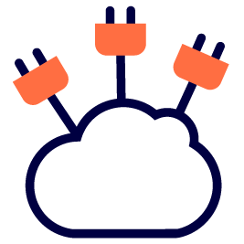
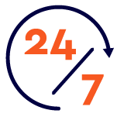
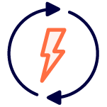

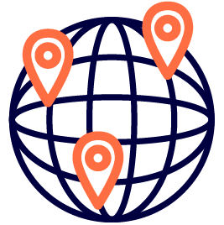
No more tradeoffs - the promise of Distributed SQL
SQL
PostgreSQL compatible
Resilience & HA
Multi/ Hybrid cloud /K8s
100% Open Source
Low Latency
Horizontal Scalability
Geo Distribution
Notes:
Talk track
Ultimately, the question is how do you have your cake and eat it too. The tradeoffs lead to the news grabbing headlines and unhappy users
One upside / downside of Shelter in place has been the baking and consumption of many a cake - and I learnt a few things
You want the base of your cake needs to have some body to support the cake - you want to have resilience and scale and distribution across availability zones and geographic zones
No self respecting cake only has one layer - You want the next layer to give you a full featured database with real ACID transactions, consistency, low latency and throughput
And we all know the Buttercream is essential - can it support multiple clouds? Is it really open source, can I really just use my expertise in SQL - or will i be forced to yet another vendor-specific “aggregation framework”

Slide 16

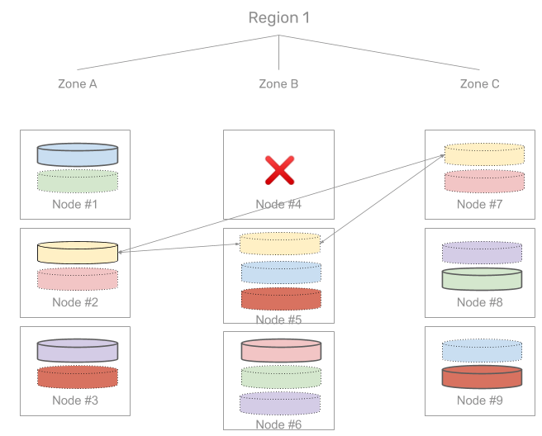
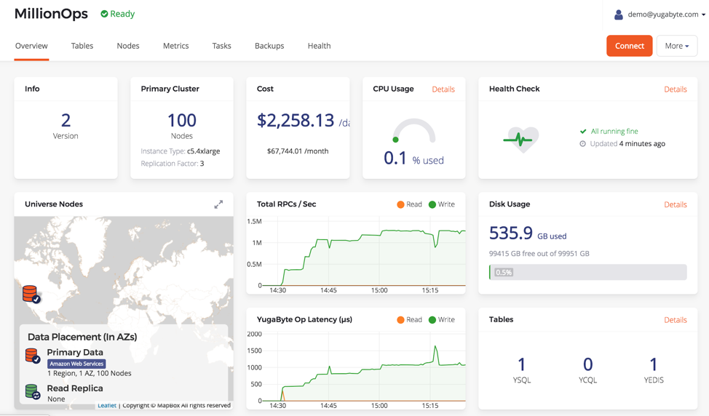
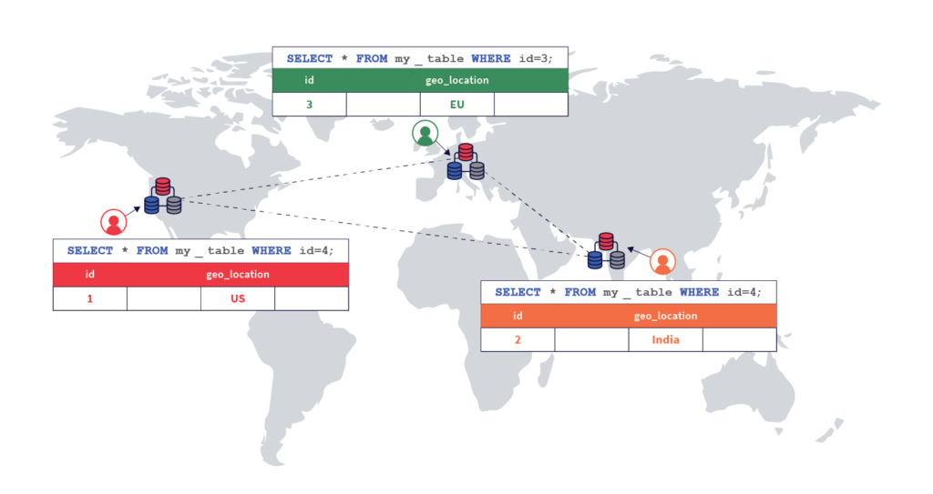
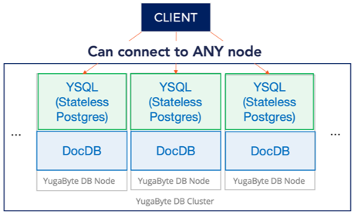
YugabyteDB - key differentiators
PostgreSQL Compatible
Resilience & HA
Horizontal Scalability
Geo-Distribution
Reuses the query layer of PostgreSQL
Offers advanced features (triggers, stored procedures, partial indexes, security, etc)
Build / modernize apps with high agility
Developers get instantly productive
Migrate legacy DBs to the cloud (Oracle / RAC, SQL Server, DB2)
Example: A large bank migrated from DB2, Justuno from SQL Server
Survives multiple failures - nodes, zones, regions/data centers
Auto-heals with re-replication
Zero-downtime upgrades & security patching
Proven in real-world scenarios at scale
Example: Sep’19 Plume continued handling billions ops/day during AWS outage of EU zone. Multiple rolling upgrades and cluster expansions
Billions of ops/day, hundreds of TB
Scale queries, storage and connections by adding nodes
Reliably scale-out and scale-in on demand with large datasets without impacting the running application
Example: Kroger and Narvar scale-out YugabyteDB to handle peak traffic (Black Friday and Cyber Monday), can scale-in after holiday season
Distribute data across zones, regions or clouds with ACID consistency
Most complete global replication features of any database: sync, async, geo-partitioning, hybrid deployments
Move data closer to customers and comply with regulations like GDPR
Example: Admiral geo-distributed data across 5 regions and 3 continents to improve user experience by achieving < 3ms read latencies
Notes:
Our existing customer base generally use us for some of these reasons and then expand from there. First is low latency, sometimes you need single-digit millisecond performance with little or no variance. IoT and a lot of financial data falls into this category but so does some publishing, retail and telecommunications.
Performance at scale is really important to a lot of industries particularly online retailers. It means not just performing “normally” but on Black friday. Yet at the same time reliability, consistency and often spanning datacenters are also important.
Geodistribution was already important for performance but it has become even more important with data sovereignty rules like GDPR. Whether you’re a financial company, retailer or logistics company. Frequently data need not only be global but consistent at scale.
Anyone global has to be multicloud. There is no Google in China. There are parts of the globe with data sovereignty rules that amazon doesn’t reach. There are places where Azure’s coverage is thin. Moreover there are datasets that can’t go to the public cloud. And if you want to negotiate price with a cloud vendor -- you better have leaving as an option.
Things fall apart, the center will not hold. Any modern infrastructure has to be able to handle multiple failures from network to servers to availability zones and entire datacenters or geographic zones.
As we move to a cloud world, and a globally competitive world, Total cost of ownership which is frequently becoming measured at an operation level -- has to be low.
Here are a few examples from our customers and our community.

Slide 17
Designed for Cloud Native Microservices
 | PostgreSQL | Google Spanner | YugabyteDB
SQL Ecosystem | ✓ Massively adopted | ✘ New SQL flavor | ✓ Reuse PostgreSQL
RDBMS Features | ✓ Advanced Complex | ✘ Basic cloud-native | ✓ Advanced Complex and cloud-native
Highly Available | ✘ | ✓ | ✓
Horizontal Scale | ✘ | ✓ | ✓
Distributed Txns | ✘ | ✓ | ✓
Data Replication | Async | Sync | Sync + Async
Yugabyte Query Layer
YCQL
YSQL
DocDB Distributed Document Store
Sharding & Load Balancing
Raft Consensus Replication
Distributed Transaction Manager & MVCC
Document Storage Layer
Custom RocksDB Storage Engine
Notes:
Google brought to life in Spanner the ideas of SQL execution against a global relational database, while maintaining consistency. YugabyteDB brought the ideas to an Open Source database. In fact one compatible with existing databases including PostgreSQL and Cassandra.
DocDB, YugabyteDB’s distributed document store common across all APIs, is built using a custom integration of Raft replication, distributed ACID transactions and the RocksDB storage engine.
DocDB’s sharding, replication/fault-tolerance and distributed ACID transactions architecture are all based on the Google Spanner design
YugabyteDB supports two flavors of distributed SQL.
YSQL is a fully relational SQL API that is wire compatible with the SQL language in PostgreSQL
YCQL has its roots in the Cassandra Query Language.

Slide 18
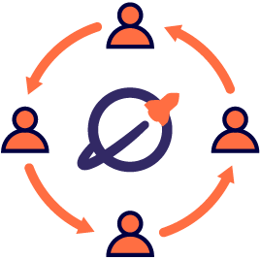
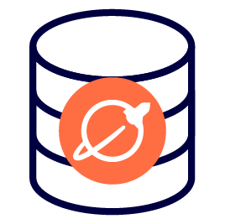
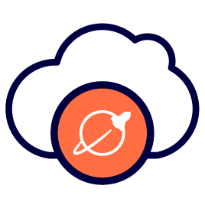
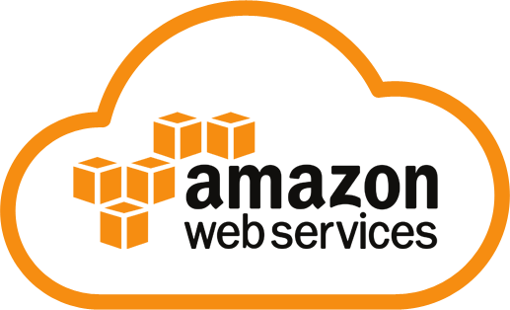
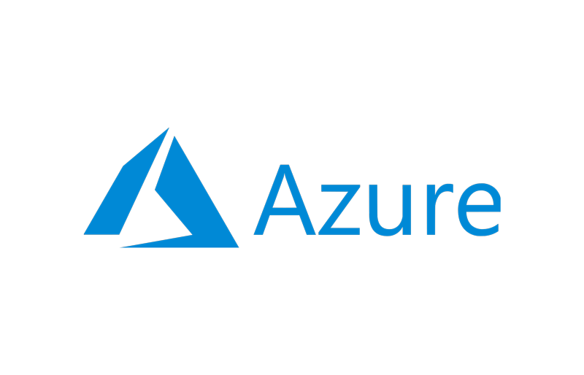
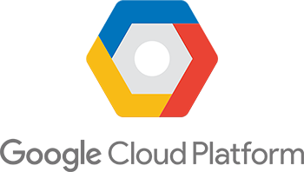
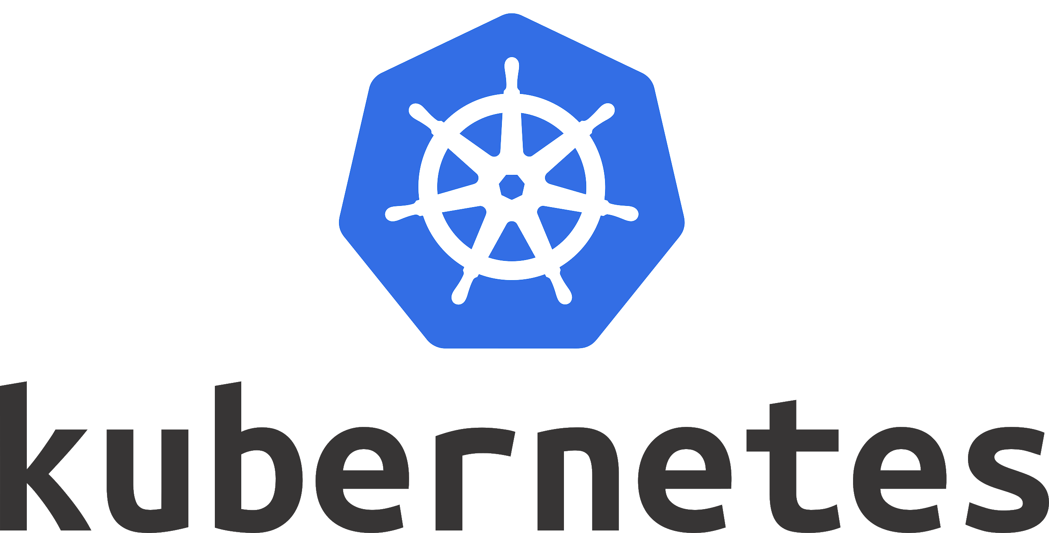
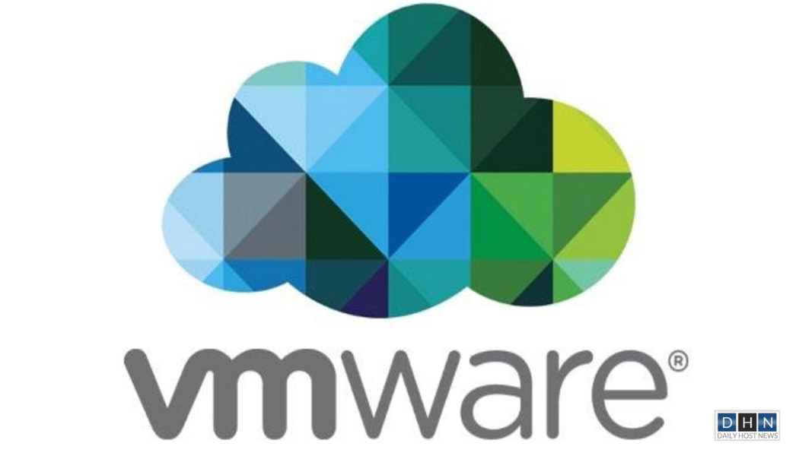
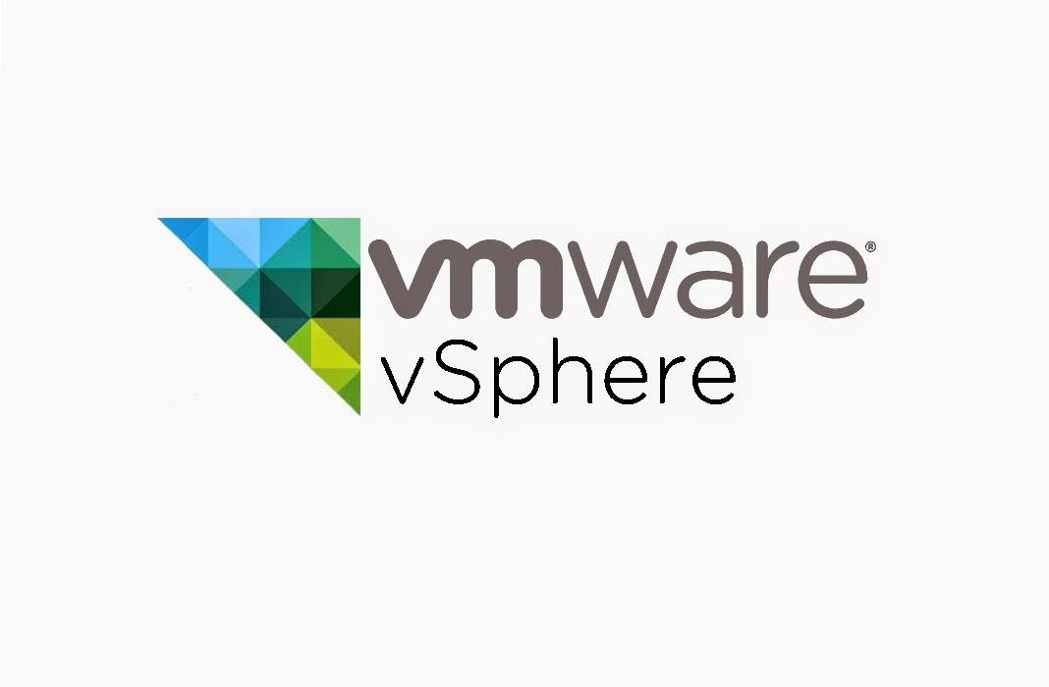
Yugabyte Offerings: Deploy and manage - where and how you choose
YugabyteDB
Yugabyte Platform
Yugabyte Cloud
Community supported
24 x 7 Enterprise support
Fully Managed DBaaS
Yugabyte
Platform UI
Self Service UI
Operational Excellence
DBaaS out of the box
https://download.yugabyte.com
Yugabyte DB
Transactional Distributed SQL DB
100% Open Source Apache 2.0
PostgreSQL compatible
Enterprise grade RDBMS
Cloud Native
Self managed
Self or Yugabyte managed
Yugabyte managed Public DBaaS
Notes:
Yugabyte DB is our core technology, it is open source under the apache license. Our Yugabyte Platform lets you build your own DBaaS so to speak. It enabled you to deploy, monitor, and manage Yugabyte on any cloud or on premise. Finally, we can manage Yugabyte for you with Yugabyte cloud, our DBaaS.

Slide 19
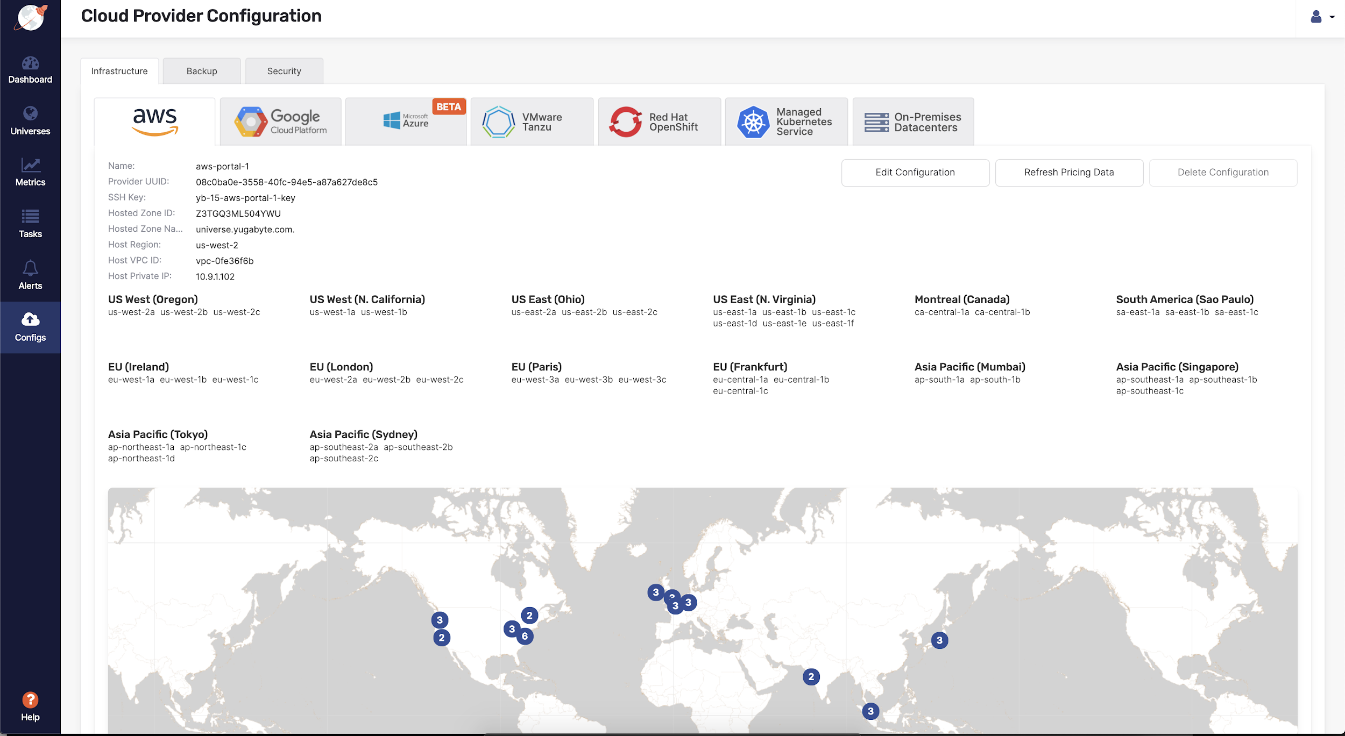
Deploy on every Cloud/Container
Notes:
The Yugabyte Platform allows you to deploy and manage YugabyteDB across multiple datacenters.

Slide 20
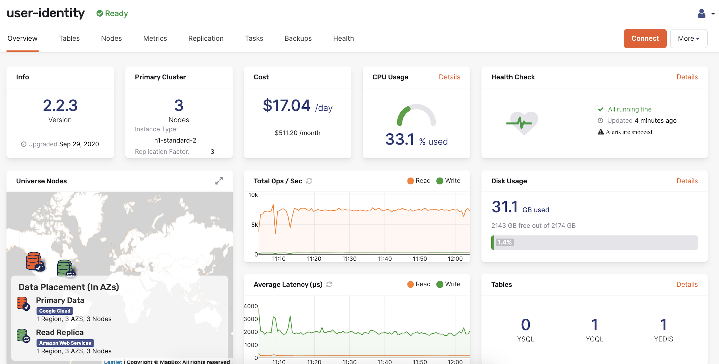
Manage and monitor universes

Slide 21

Yugabyte Services - we’ve got you covered
YB Kickstart
Everything you need to get up and running
Cloud specific validated instances
Security and Encryption Integration
YugabyteDB DBA Training
Managed Yugabyte Platform
Travis Logan,
CTO/Co-founder, Justuno.com
Remote managed cloud powered by YB Platform
Managed OS and Software Upgrades
Managed Backups
24x7 monitoring/alerting
With YugabyteDB I feel like we’re Partnering to make the product better …..and the team cares about our success.
From day one, I could tell this was going to be a not just a great support system for us, but great partnership.
And, it only blossomed from there.
Migration Services
Move your existing RDBMS and NoSQL to YB
SQL and noSQL migrations
Public/Private/hybrid cloud migrations
Expert Services
Help from the experts
Platform Design & Architecture
Scaling, Performance and Optimization Services
Best Practices and Operational Guidance
Cluster Health Assessment

Slide 22

Key Features
Low Latency
In production with <2ms reads <10ms writes
Billions of operations, hundreds of Terabytes across many nodes
Kubernetes based deployment works on VPCs, on-premise or across multiple cloud providers
Data may be spread across AZs, regions and even cloud providers while supporting GDPR/etc.
Survives multiple failures, even entire data centers
Lower cost per operation vs NoSQL, Amazon DynamoDB, etc.
Scalability
Multi-Cloud
Geo Distribution
Resilience & HA
TCO
Notes:
Our existing customer base generally use us for some of these reasons and then expand from there. First is low latency, sometimes you need single-digit millisecond performance with little or no variance. IoT and a lot of financial data falls into this category but so does some publishing, retail and telecommunications.
Performance at scale is really important to a lot of industries particularly online retailers. It means not just performing “normally” but on Black friday. Yet at the same time reliability, consistency and often spanning datacenters are also important.
Geodistribution was already important for performance but it has become even more important with data sovereignty rules like GDPR. Whether you’re a financial company, retailer or logistics company. Frequently data need not only be global but consistent at scale.
Anyone global has to be multicloud. There is no Google in China. There are parts of the globe with data sovereignty rules that amazon doesn’t reach. There are places where Azure’s coverage is thin. Moreover there are datasets that can’t go to the public cloud. And if you want to negotiate price with a cloud vendor -- you better have leaving as an option.
Things fall apart, the center will not hold. Any modern infrastructure has to be able to handle multiple failures from network to servers to availability zones and entire datacenters or geographic zones.
As we move to a cloud world, and a globally competitive world, Total cost of ownership which is frequently becoming measured at an operation level -- has to be low.
Here are a few examples from our customers and our community.

Slide 23
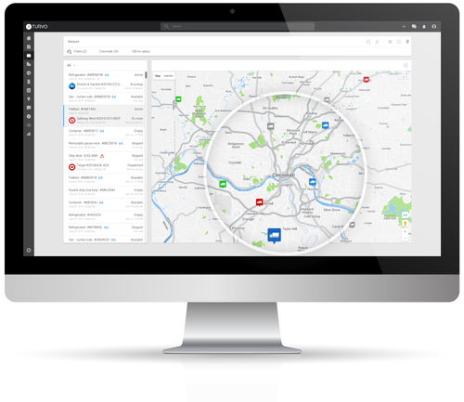
Logistics
Goal was 5-10ms; achieved <2ms for writes; < 1ms for reads
30TB with 5x compression; ~3500 transactions/sec Using TTL to auto-expire old data
Require a low cost of storage, and low cost of operation Achieved lower TCO than MongoDB or DynamoDB
Every truck, everywhere, every event -- all of the time
Low Latency
Scalability
TCO
Real time fleet location and shipment location
Handles 1000s of real-time geospatial updates, events and other supply chain data every second
Customers and partners include Ryder and DHL
Resilience
Notes:
ADDED SPECIFICALLY FOR RYDER MEETING Turvo handles fleet management for carriers, tracking for brokers and shipment tracking for shippers. They handle real-time data from trucks including geospatial and events. It is a lot of time series data. Key to their choice of Yugabyte was the importance of data fidelity, they need to know what entered what facility when and where. Moreover, they liked having the overall data structure behind Cassandra but have found Yugabyte to be the only database they haven’t had to mess with. They partner with companies like Ryder and DHL so they have a lot of volume for a company their size and keeping the cost per operation low is just as important as scale or latency.

Slide 24
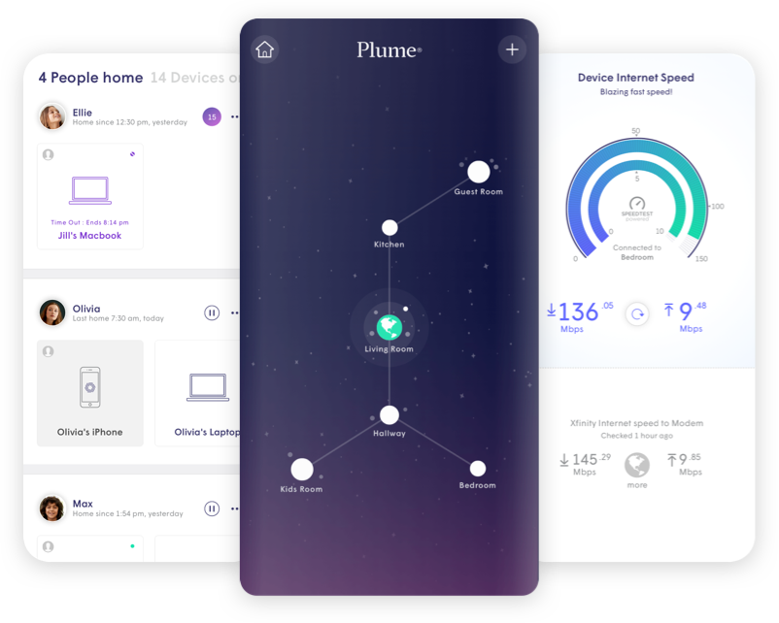
Internet of Things
Low Latency
Each device creates hundreds of events which need to get persisted with low latency
+27B ops/day & +35TB dataset. Projected 2020 growth: +75B ops/day & +85TB dataset
Deployed on AWS in Plume’s VPC and partner VPCs
Multi-AZ, Multi-Region deployment. GDPR Compliance
Every device, all over the world, all of the time
Scalability
MultiCloud
Smart Wifi Platform
Powers millions of smarthomes
Plume’s customers are the world’s largest ISPs including Comcast, Sky and Bell Canada
Geo Distribution
Resilience
Notes:
A lot of ISPs like Comcast and Sky have gotten into the smart home business. Plume manages the wifi devices as well as all of the smart devices that connect to them. This generates a lot of events and Yugabyte has to keep up and cannot cause a wait. Many of those devices can’t queue and even if they could it would be noticed (i.e. when you change the temperature on your smart thermostat you expect an immediate response). This creates a large amount of data, billions of operations per day and a 35 terabyte dataset -- that is more than doubling in a year. Plume deploys Yugabyte in their AWS virtual private cloud but also their partners deploy the whole stack including Yugabyte in their VPCs. This is clearly a global enterprise and crosses national boundaries and there are a lot of rules about what data lives where. And plume is clearly a 24x7x365 operation.

Slide 25
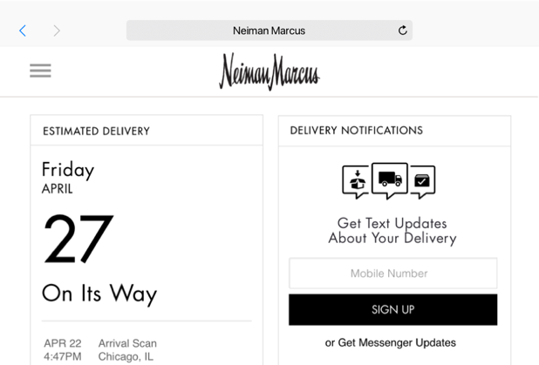
Online-Retail
Low Latency
<2ms read and <10ms write latency
2B+ ops/day with huge peaks around Black Friday and Cyber Monday.
6 node, multiple-zone deployment. GDPR compliance requires data locality and multi-region capabilities.
No service interruptions during spikes
Achieved 4x lower TCO than DynamoDB, PostgreSQL, and Elasticache
Scalability
Geo Distribution
Retail Experience Management
Delivers personalized experiences for Gap, Neiman Marcus, Levis, etc.
10+ critical microservices on Yugabyte
Resilience
TCO
Notes:
Narvar is behind personalization for a lot of major retailers including Nike and Walmart. They’ve achieved low latency for both reads and writes at massive scale. They have to stay up on Cyber Monday and black friday. Part of their move to Yugabyte was to reduce complexity but also to achieve a lower cost per operation.

Slide 26

Financial Services
Low Latency
< 10ms for batch writes & range queries
10B ops per day; 60 TB dataset; handling 200K+ transactions / sec at peak
Multiple AZs, multiple regions
Achieved lower TCO and complexity by replacing Redis and AWS RDS
Scalability
Geo Distribution
Provides market data as APIs and microservices.
Tick by tick and bid/ask data
Customers include BlackRock, Charles Schwab, TIAA, and SoFi
TCO
Notes:
Xignite handles stock ticker and financial market data. They are the backend for some of the major financial companies and have to handle both a lot of data and at low latency. They replaced redis and AWS RDS with Yugabyte to get both caching and a datastore.

Slide 27

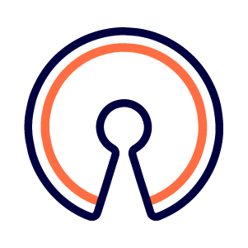
Telecommunications
Low Latency
Must handle CDR writes in real-time
10B ops per day, 50 TB dataset
GCP and AWS as well as on-premise
Multiple AZs, multiple regions
Cost per call must be kept low
Open source system that integrates with Hasura (GraphQL), Kafka, OpenSIPS, etc.
Scalability
MultiCloud
Geo Distribution
Business VOIP and SIP platform with Cloud PBX services
Provides 24/7x365 network surveillance and monitoring
an open-source rating engine used for carrier-grade, multi-tenant, real-time billing
TCO
Open Source
Notes:
SKIPPED TEMPORARILY FOR RYDER
Voiceland both has to provide customers the lowest cost for a call, and integrate into their open source stack. For them Yugabyte’s multi-cloud, massive scale and low latency were critical but so was lowering their TCO and that yugabyte is apache Licensed and integrated into Hasura their GraphQL solution.

Slide 28
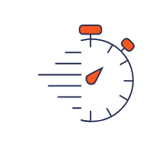




Your Yugabyte Customer Success: “PRESS” Framework
Organize and measure business outcomes by laying out the foundational metrics
Productivity
Resiliency
Increase rate of innovation and competitiveness by bringing new ideas to production within hours/days
Yugabyte DB ensures that apps will continue to work smoothly without any performance impacts despite nodes / zone failures
Savings
Optimally allocate resources with a horizontally scalable distributed database for low upfront costs
Efficiency
Security
DB Operators can offer internal DBaaS, make high-impact changes frequently and predictably with minimal toil
Quickly patch any security issues and limit threat surface also allowing for timely rotation of security credentials

Slide 29








About Us
Bill Cook
CEO
Kannan Muthukkaruppan
President/Co-founder
Karthik Ranganathan
CTO/Co-founder
Mikhail Bautin
Software Architect/Co-founder
Founded Feb 2016
Funded by leading cloud-infra VCs
Notes:
As a company Yugabyte is young, but our founders go back decades in database development starting at Oracle. They were also key people on the teams at Facebook that created Cassandra and HBase and were responsible to running them “as a Service” at a scale few companies have seen. Our backers are early investors in Informatica, TimesTen, Docusign, Asana and DoubleClick. These are investors that understand the database market, cloud computing and service business.

Slide 30
Suggested 4-week plan
Identify a core team / champion to work with assigned YB team
Discuss existing data challenges
Schedule a technical deep-dive
Try it out: https://download.yugabyte.com/
Hands-on and deep dive workshop [~ 4hrs]
Outcome from workshop is use cases & applications that require hybrid-cloud deployment / high resilience in Database layer
Identify business metrics for success
POC run to validate use case and results [2-3 weeks]
Report back to exec team on results and go forward next steps
Notes:
So I’d like to learn more about your current challenges. What kinds of data challenges are you facing?
Based on some of the things you’ve told me, if you think this might be a good fit or something that interests you I’d like to schedule a deep dive with some of our engineers and go in more depth about your data challenges and how the technology works.
Regardless of that, please kick the tires. See how Yugabyte works! We think to know it is to love it.

Slide 31

Thank You
Join our community yugabyte.com/slack
Try for yourself download.yugabyte.com
Notes:
Thanks again for your time. We’ve got an active community on github and on slack. While I’m available to you and happy to answer any questions in followup -- you’ll also find our community is very active and happy to talk as well both other users and our developers.

